Slide 1
Pedaling Towards Membership Growth
A Data-Driven Marketing Strategy for Cyclistic
Dave R. Lashley / FEB 14, 2025

Slide 2
Agenda
Introduction
Data Collection & Preparation
Rider Behavior Analysis
Membership Conversion Strategies
Final Tips & Takeaways

Slide 3

Introduction
Analyze Cyclistic rider behavior to create a data-driven marketing plan that converts casual users into annual members

Slide 4

Data Collection & Preparation
Data from Amazon AWS (2024) included casual riders and members
Analyzed 4,202,561 unique trips
Data was cleaned to ensure trip uniqueness
Only trips 1 minute or longer were analyzed

Slide 5
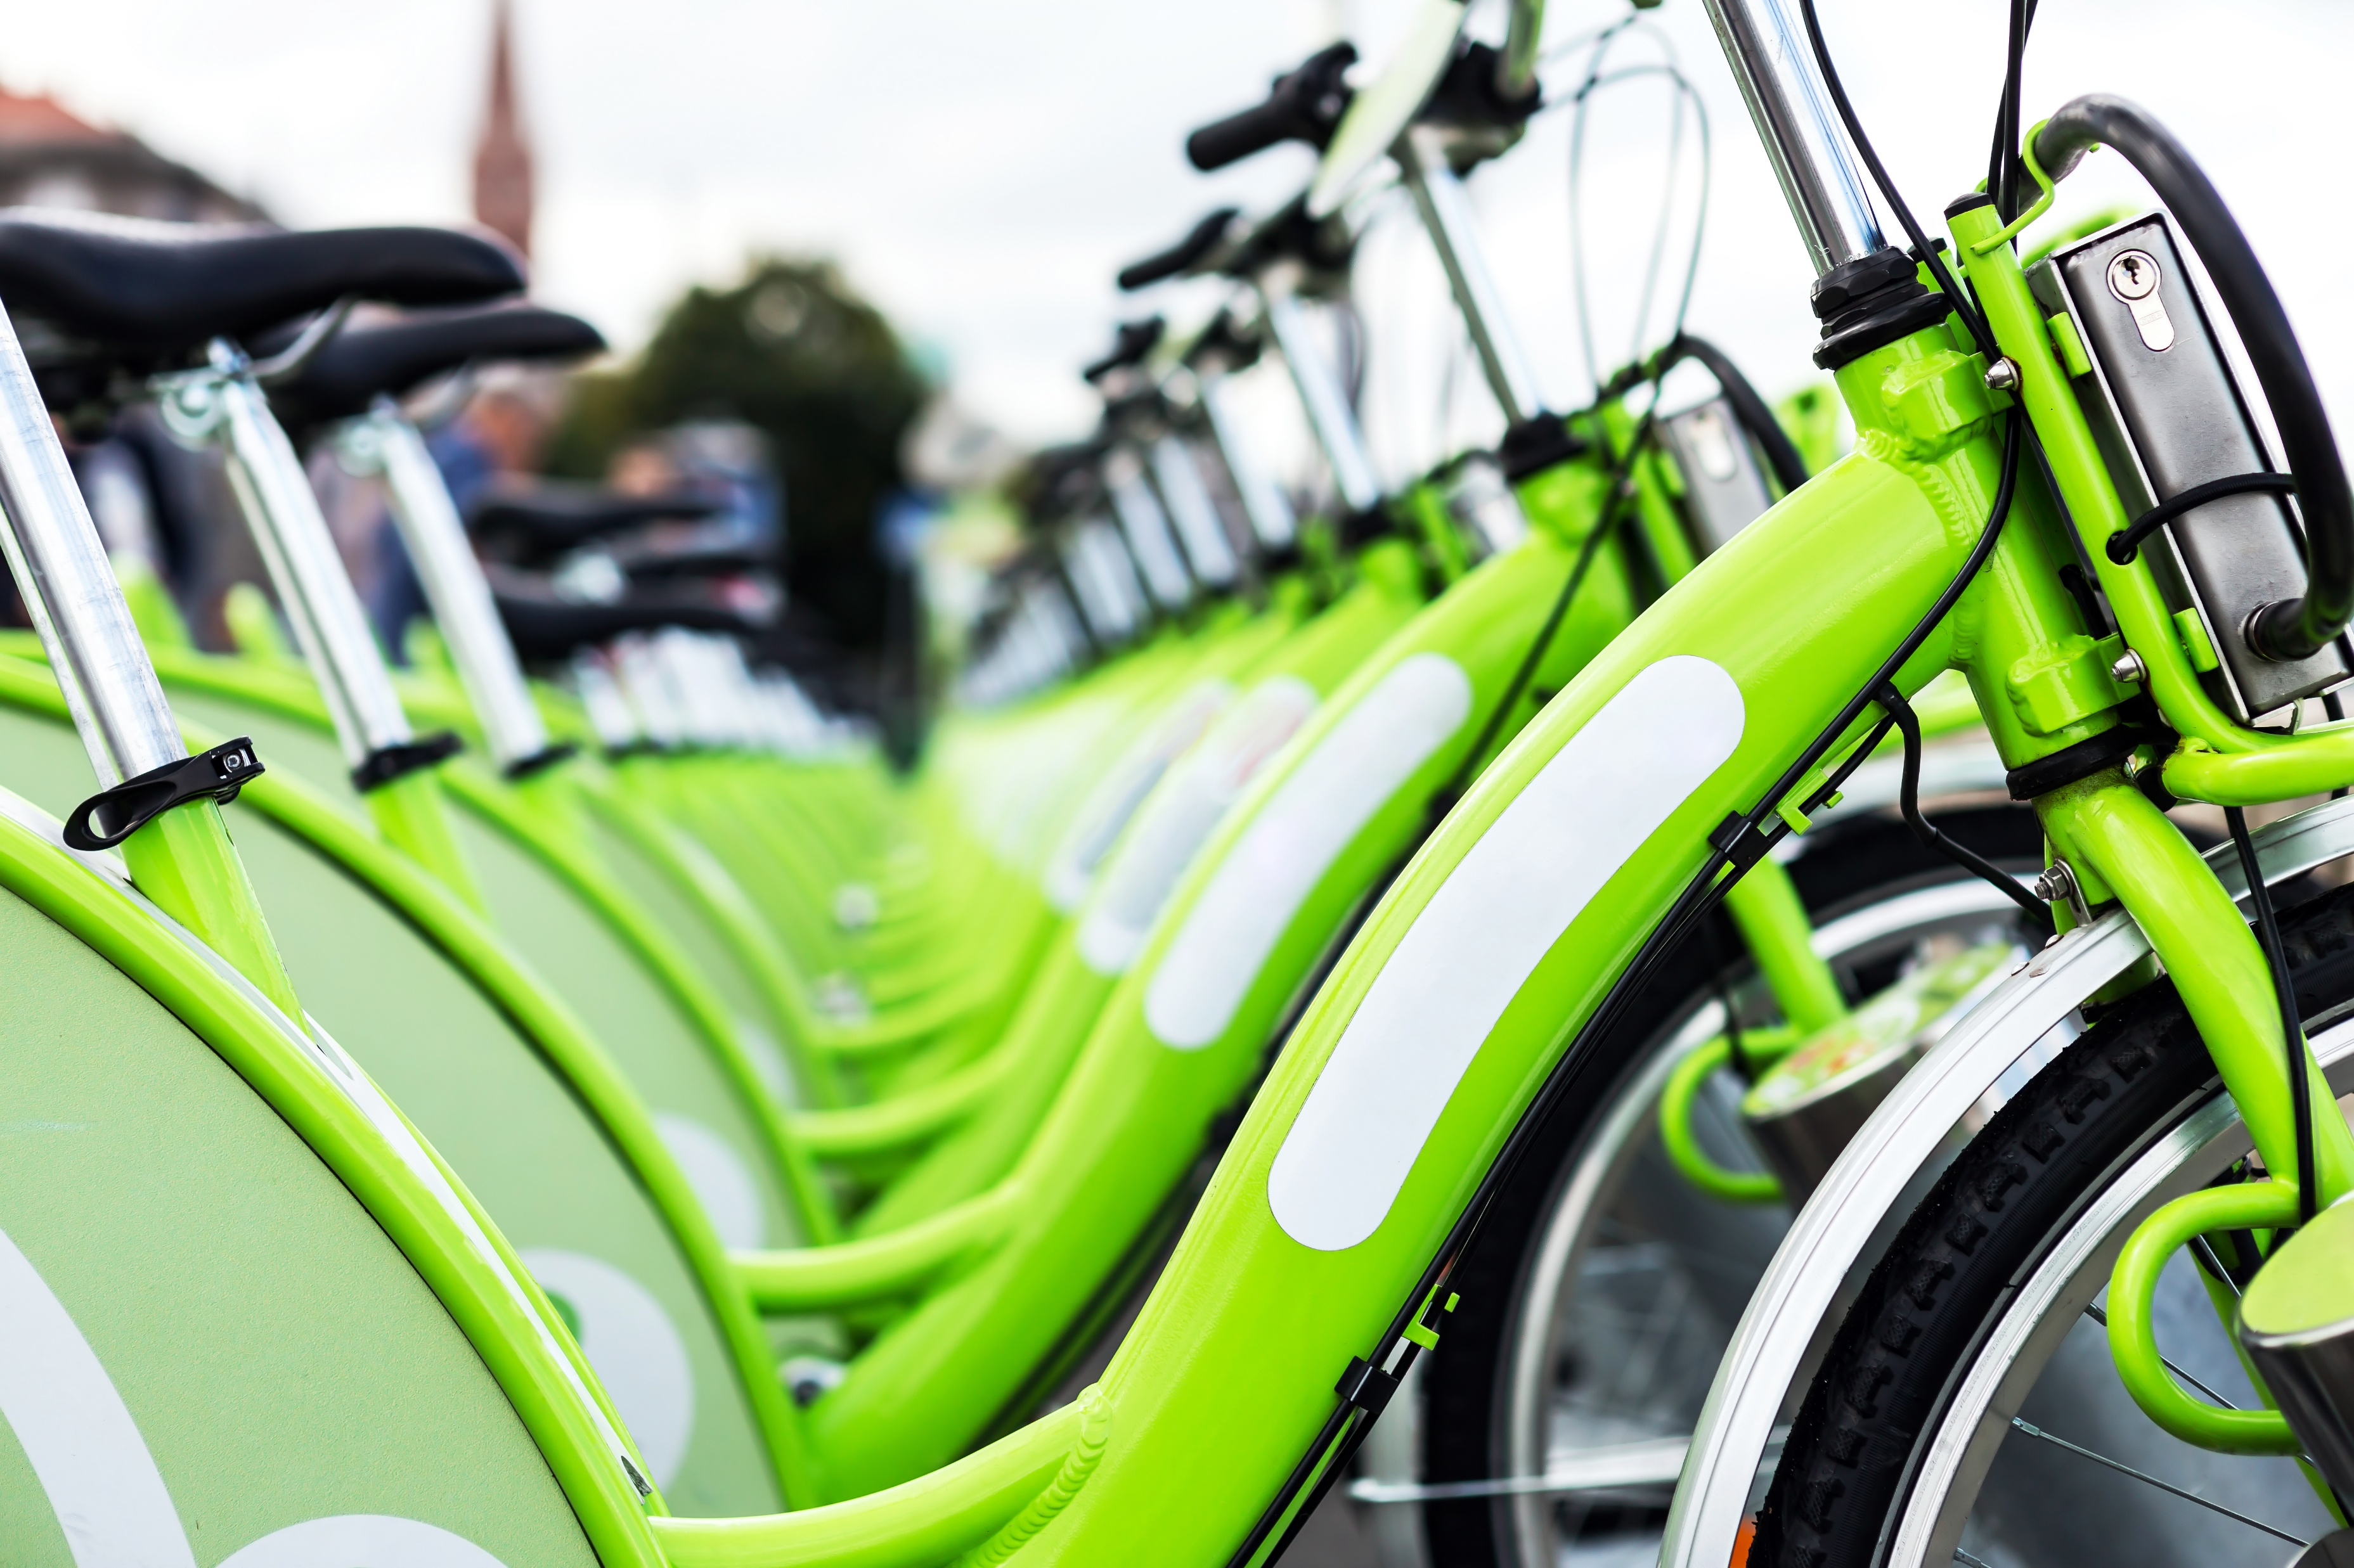
Rider Behavior Analysis
Usage Patterns and Trends

Slide 6
Members vs Casual Riders
Members take 1.7x more rides than casual riders
Casual riders take nearly 2x longer trips
Casuals prefer round trips; members use repeat stations
Both prefer classic bikes over electric bikes or scooters

Slide 7
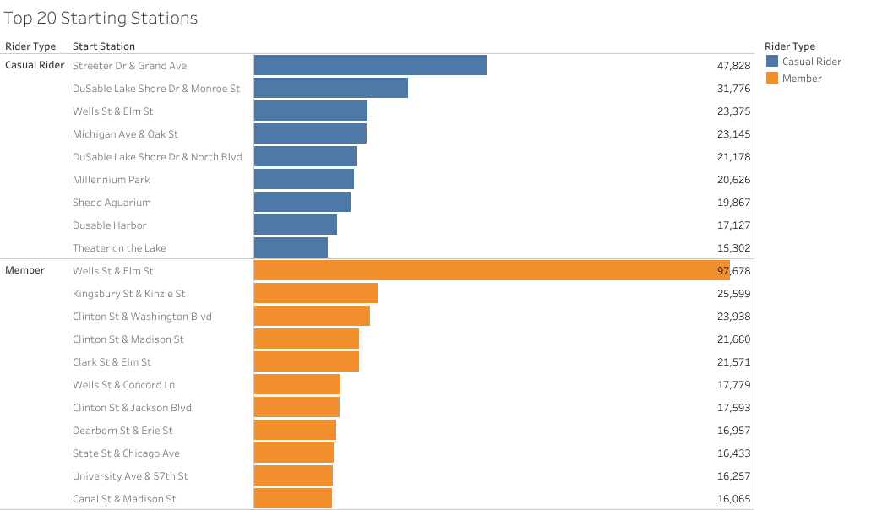
Popular Starting Stations
An average of 220K+ casual riders use these stations, presenting a strong opportunity for membership conversion

Slide 8
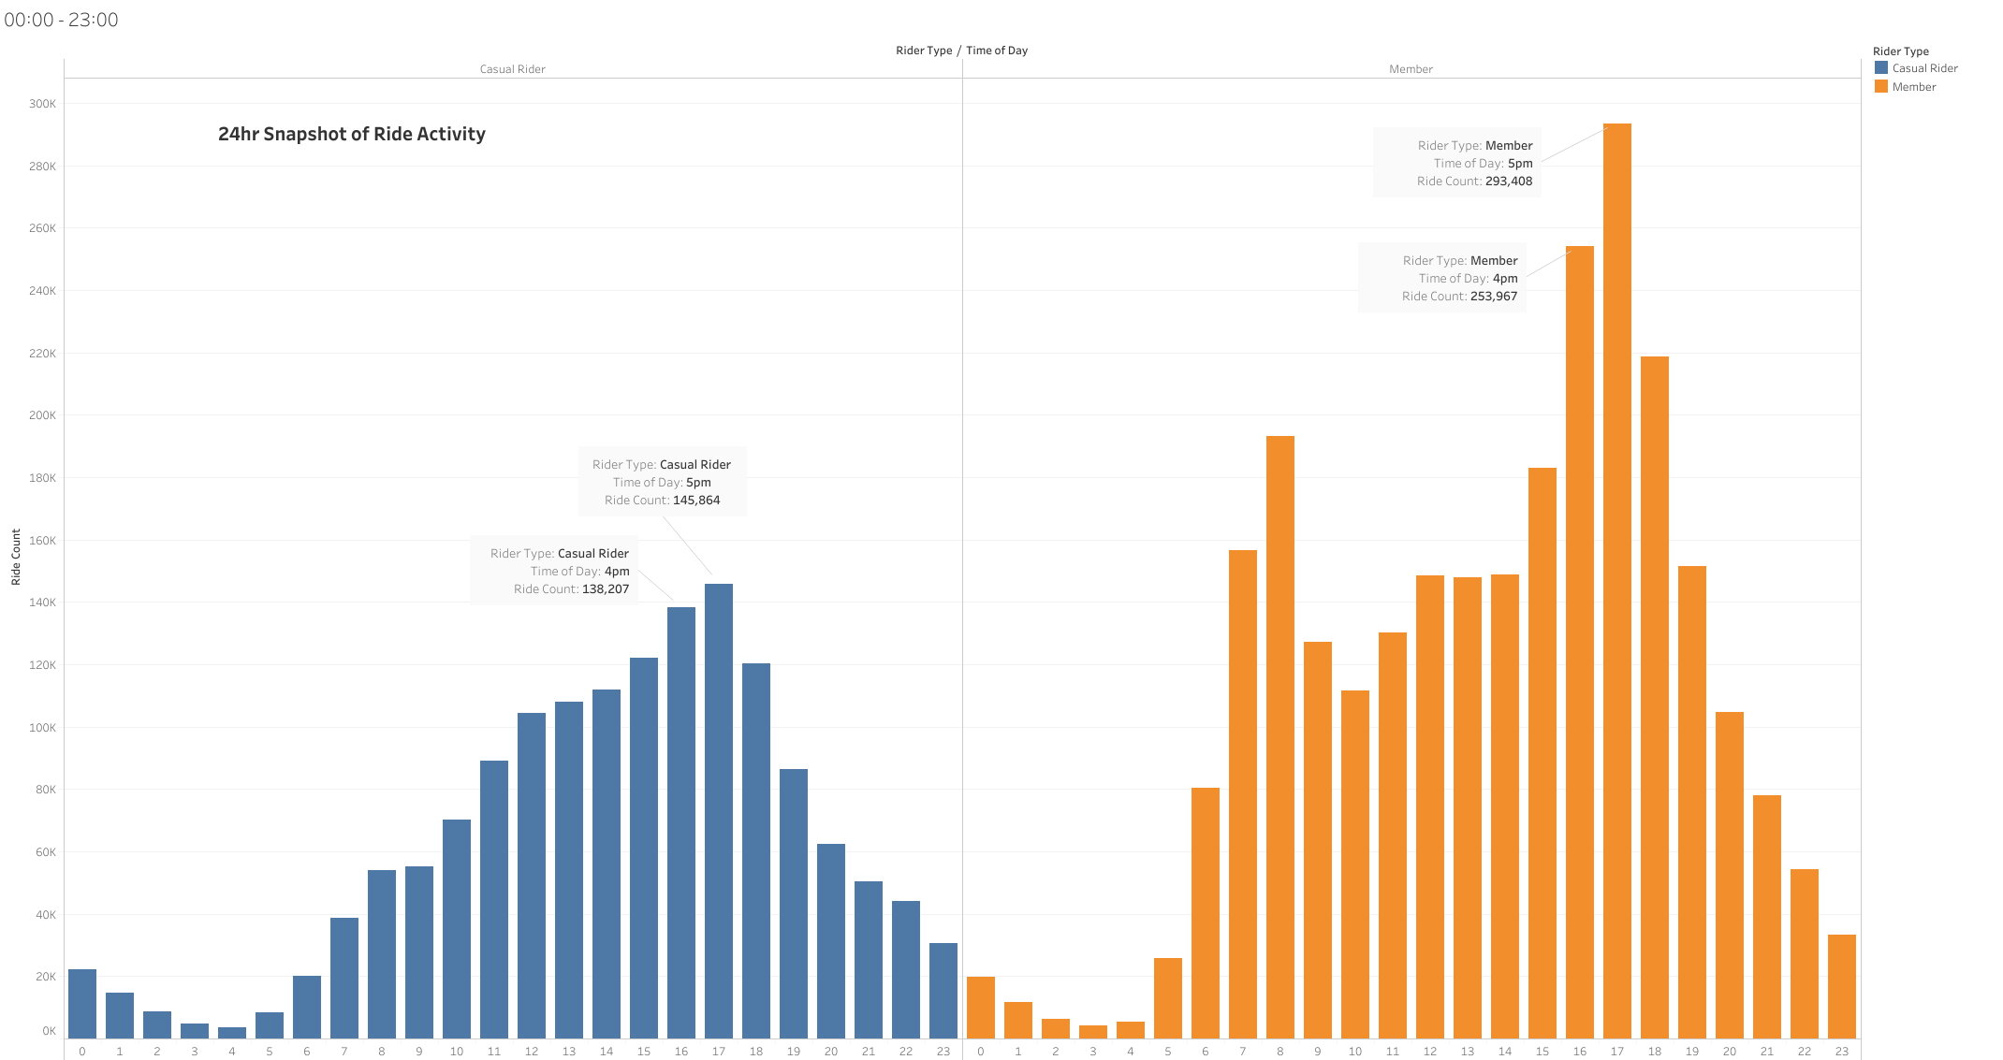
Peak Ride Hours
5pm is busiest for both groups followed by 4pm

Slide 9
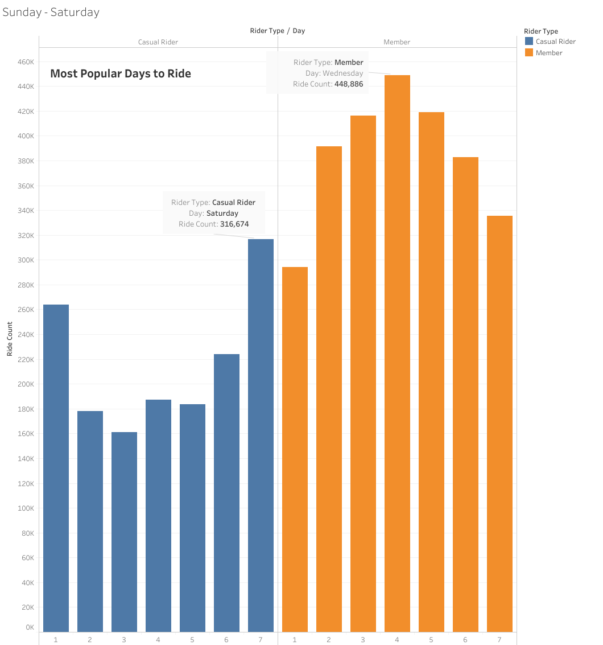
Peak Ride Days
Casual Riders: Peak on Saturday with 316K+ users
Members: Peak on Wednesday with 448K+ users

Slide 10
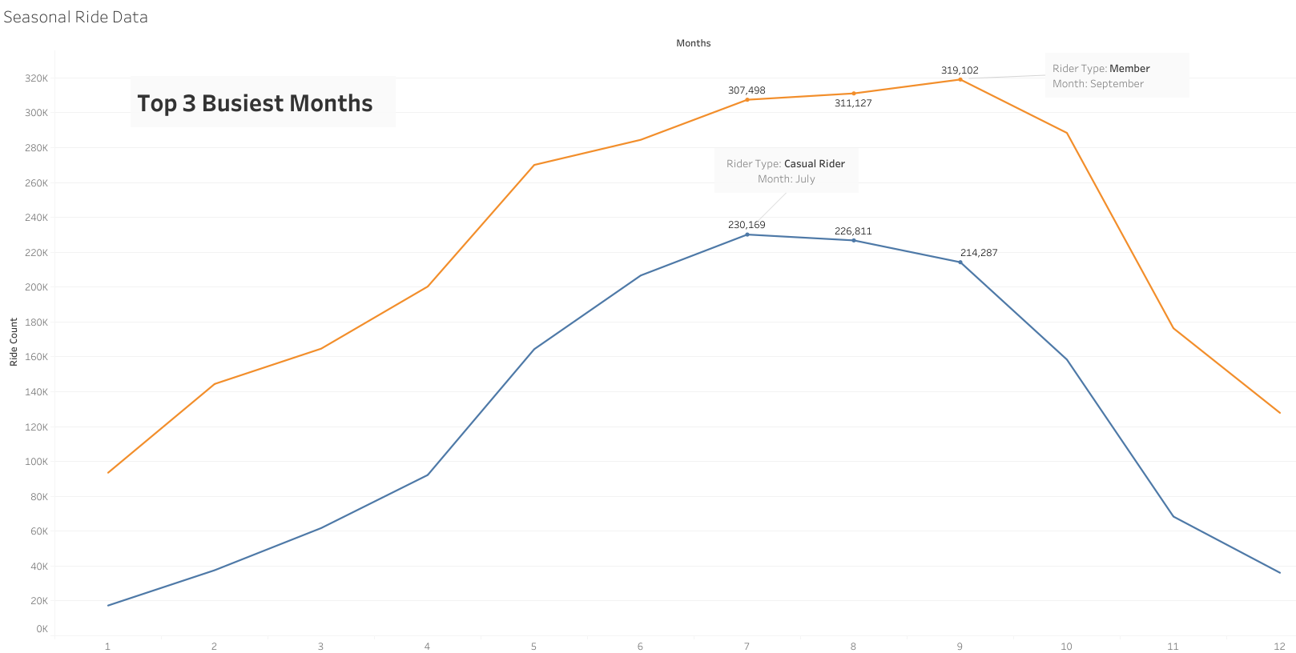
Seasonal Rides
Peak Rides: Mid-summer to early fall (July - Sep)
Lowest Rides: Winter season.
Members have highest ridership in all seasons.

Slide 11
Membership Conversion Strategy
Maximizing Rider Retention

Slide 12
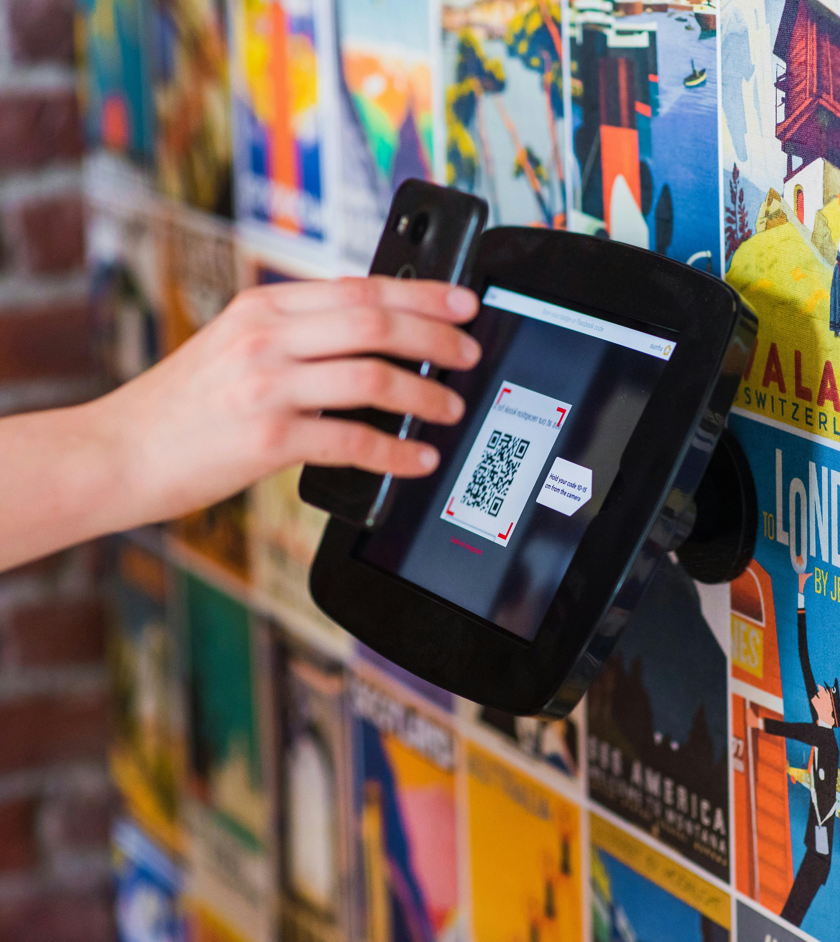
Immediate Conversion Plan:
Seamless Sign-Up Process:
QR codes for instant activation or trial membership access
Exclusive Discounts for First-Time Memberships
Highlighted cost savings at checkout, showcasing valuable membership perks

Slide 13

Ongoing Plan:
Peak Time Perks & Rewards:
Priority Access: Members skip the wait with exclusive lanes at top stations
Commute & Save: Bigger rewards for frequent rush-hour riders
Bonus Days: Extra points on Wednesdays & Saturdays
Referrals: Discounts & perks for referring friends

Slide 14

Seasonal Plan:
Promotions:
Long Ride Rewards: Casuals unlock exclusive membership deals on extended trips
Event Partnerships: Discounted memberships or free access to festivals
Summer Ride Pass: Low-cost seasonal membership to build riding habits

Slide 15
Final Tips & Takeaways
Target High-Usage Casual Riders: Focus on converting the 869K+ riders who already exceed 12-minute trips
Capitalize on Peak Times: Prioritize conversion efforts around 5 PM and key days (Wednesday for members, Saturday for casuals)
Leverage Round-Trip Behavior: Casual riders’ frequent round trips present an opportunity to push membership benefits for cost savings
Encourage Habit Formation: Summer and Fall are peak seasons—use incentives like seasonal passes and priority perks to lock in conversions
Make Membership the Obvious Choice: Highlight exclusive benefits like ride credits, priority access, and referral discounts to drive long-term engagement

Slide 16
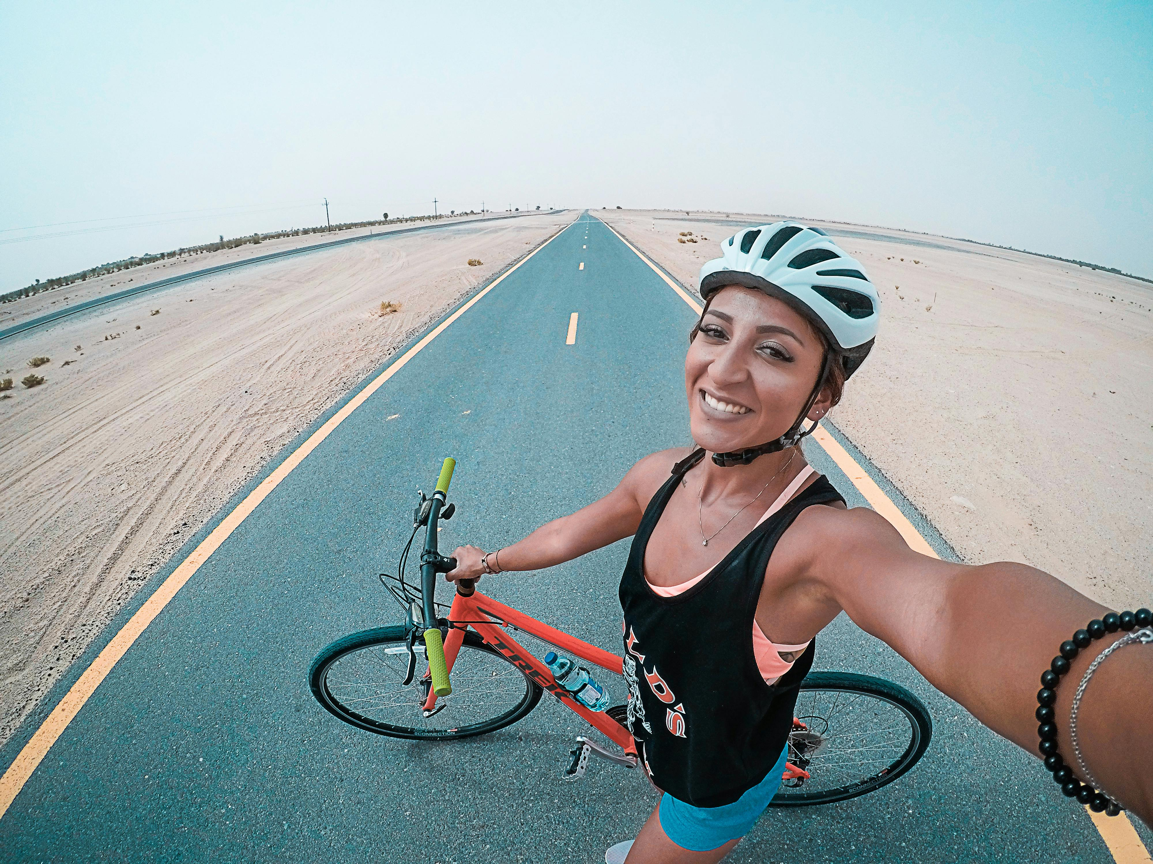
Thank you
Dave R. Lashley
D.Lashley.Strategy@Gmail.com

